Slide 1
Machine learning Intro

Slide 2
What is ML
Not a well defined definition
Arthur Samuel (1959)Machine learning: "Field of study that gives computers the ability to learn without being explicitly programmed"
Samuels wrote a checkers playing program
Had the program play 10000 games against itself
Work out which board positions were good and bad depending on wins/losses

Slide 3
What is ML
Tom Michel (1999) Well posed learning problem: "A computer program is said to learn from experience E with respect to some class of tasks T and performance measure P, if its performance at tasks in T, as measured by P, improves with experience E."
The checkers example,
E = 10000s games
T is playing checkers
P if you win or not

Slide 4
Learning Algos
Supervised learning Teach the computer how to do something, then let it use it;s new found knowledge to do it
Unsupervised learning Let the computer learn how to do something, and use this to determine structure and patterns in data

Slide 5
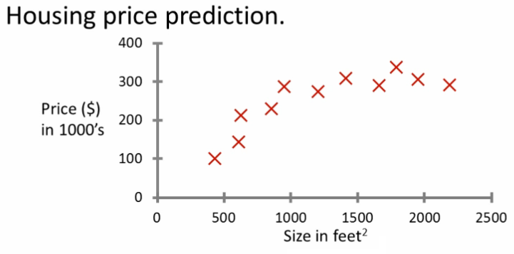
Supervised learning
Given this data, a friend has a house 750 square feet - how much can they be expected to get

Slide 6
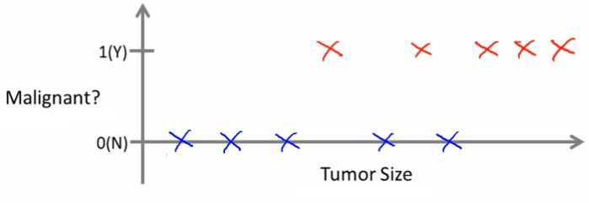
Can we definer breast cancer as malignant or benign based on tumour size

Slide 7


Slide 8
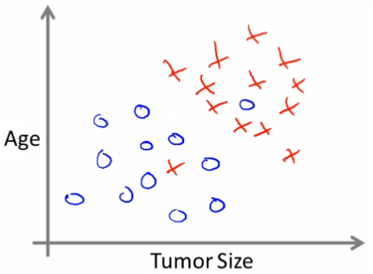

Slide 9
Unsupervised learning
Here is a data set, can you structure it? One way of doing this would be to cluster data into to groups
Google news
Groups news stories into cohesive groups
Used in any other problems as well
Microarray data
Have a group of individuals
On each measure expression of a gene
Run algorithm to cluster individuals into types of people
Social network analysis
Customer data

